Slide 1
A Short Course to Learn SQL Basics
Lesson 2: Functions and Sorting Data
Kevin Patrick
Ryan Kuhns
Michael Headlee

Slide 2
Course Outline
Intro to SQL and relational databases
Functions and sorting data
Conditional column calculations and subsets of rows
Summarizing data across rows (i.e.: grouping)
Combining data from multiple tables
Using subqueries
Review of lessons 1-6 and examples with more complex functions
Stored procedures and parameters
Modifying and maintaining data
Overall review and real world and student submitted examples

Slide 3
Course Outline
Intro to SQL and relational databases
Functions and sorting data
Conditional column calculations and subsets of rows
Summarizing data across rows (i.e.: grouping)
Combining data from multiple tables
Using subqueries
Review of lessons 1-6 and examples with more complex functions
Stored procedures and parameters
Modifying and maintaining data
Overall review and real world and student submitted examples

Slide 4
What is a function?
It’s a rule for transforming a value (or values) into another value.
Scalar functions
operation performed on a single row or value
Aggregate functions
operation performed on multiple rows
Notes:
A function is just a set of rules for transforming a value or group of values into another value.

Slide 5


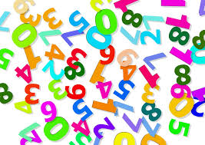

Four types of functions
Character functions
Date/time functions
Numeric functions
Conversion functions
You can also nest multiple functions to create a composite function

Slide 6
Each column defines the type of data that can be stored
DataType Group | Datatype | Nullability | Example
Numeric | int | Not Null | 57
 | decimal | Not Null | 57.62
 | decimal | Null | Null
Character | varchar | Not Null | ‘Billy Madison’
 | char | Not Null | ‘20002’
 | Char | Null | Null
Date/Time | date | Not Null | ‘2016-06-15’
 | datetime | Not Null | ‘2016-06-15 09:13:50’
Notes:
There are numerous datatypes that can be defined for a column, but they fall into three broad categories:
Numeric
Int is a common one that stands for integers which do not have decimal places
Decimal is a numeric datatype that allows for decimal places
Character datatypes can include any letter from the alphabet, numeric digits, and special characters like the *
Notice that values for character datatypes require single quotes
Date and time datatypes as you might have guessed are used to represent date and time values. Values also must be surrounded by single quotes
The date datatype allows for date functions to be applied, which we’ll cover at a later time.

Slide 7
Character functions
Select left( ‘sunlight’ , 3) as Answer
Select right( ‘George Washington ’ , 10) as LastName
Select right(rtrim( ‘George Washington ’) , 10) as LastName
Answer
sun
LastName
hington
LastName
Washington

Slide 8
Date/time functions
Select getDate() as TodaysDate
Select DatePart(year, getDate()) as TodaysYear
Select DateDiff(year, ’1908-10-14’, getdate()) as CubsLastWS
TodaysDate
2016-06-22 11:08:02.349
TodaysYear
2016
CubsLastWS
108
Notes:
Allow for manipulation of date and time values

Slide 9
Numeric functions
Transform numeric values
Select round(157.365,1) as TheAnswer
Select round(157.365,-1) as TheAnswer
TheAnswer
157.400
TheAnswer
160.000

Slide 10


Conversion functions
Select put(2016,4.) as CharacterYear
Select cast(2016 as char) as CharacterYear
Select input(2016,8.) as NumericYear
Select cast(‘2016’ as int) as NumericYear
Notes:
The fourth type of function is a conversion function. It transforms a value from one data type to another

Slide 11
Numeric function differences between SQL and SAS’s Proc SQL
Aggregate functions that are the same for SAS and SQL (for example, Sum()) can either aggregate a single column, or aggregate across columns for an entire row.
Select Sum(Column1) As ColName
From ExampleTable
Select Sum(Column1, Column2) As ColName
From ExampleTable
Aggregate functions like Sum() return the sum of a single column.
Select Sum(Column1) As ColName
From ExampleTable
Notes:
The fourth type of function is a conversion function. It transforms a value from one data type to another

Slide 12
Numeric function differences between SQL and SAS’s Proc SQL
SQL Function | SAS Function | What the function does
AVG | MEAN | Average (mean) value
Count, Freq | N | # of nonmissing
Max | Max | Largest
Min | Min | Smallest
Sum | Sum | Sums up #s
Notes:
The fourth type of function is a conversion function. It transforms a value from one data type to another

Slide 13
Components of a SQL Query
Select
From
<Where>
<Group By>
<Having>
<Order By>
Statements in SQL query must appear in this order.
Statements with <> are optional. Include only those necessary for your query.

Slide 14
Components of a SQL Query
Select
From
<Where>
<Group By>
<Having>
<Order By>
Tells SQL which existing or calculated columns to return
Tells SQL where to query data from
Orders rows by specified columns

Slide 15
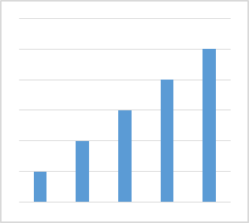
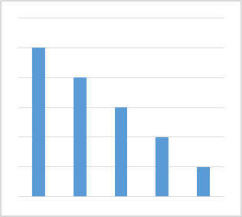
Sorting
Select FirstName, LastName, State
From CustomersTable
Order by State DESC
ASC
DESC
Ascending
Descending

Slide 16
A note on sort order
When sorting in ascending order
1. NULL values
2. Numeric values
3. Character values
Capitalization doesn’t matter

Slide 17
How SQL processes your query
You specify:
Select
From
Order By
SQL processing order:
From
Order By
Select
This can affect what is returned in your query

